Slide 1
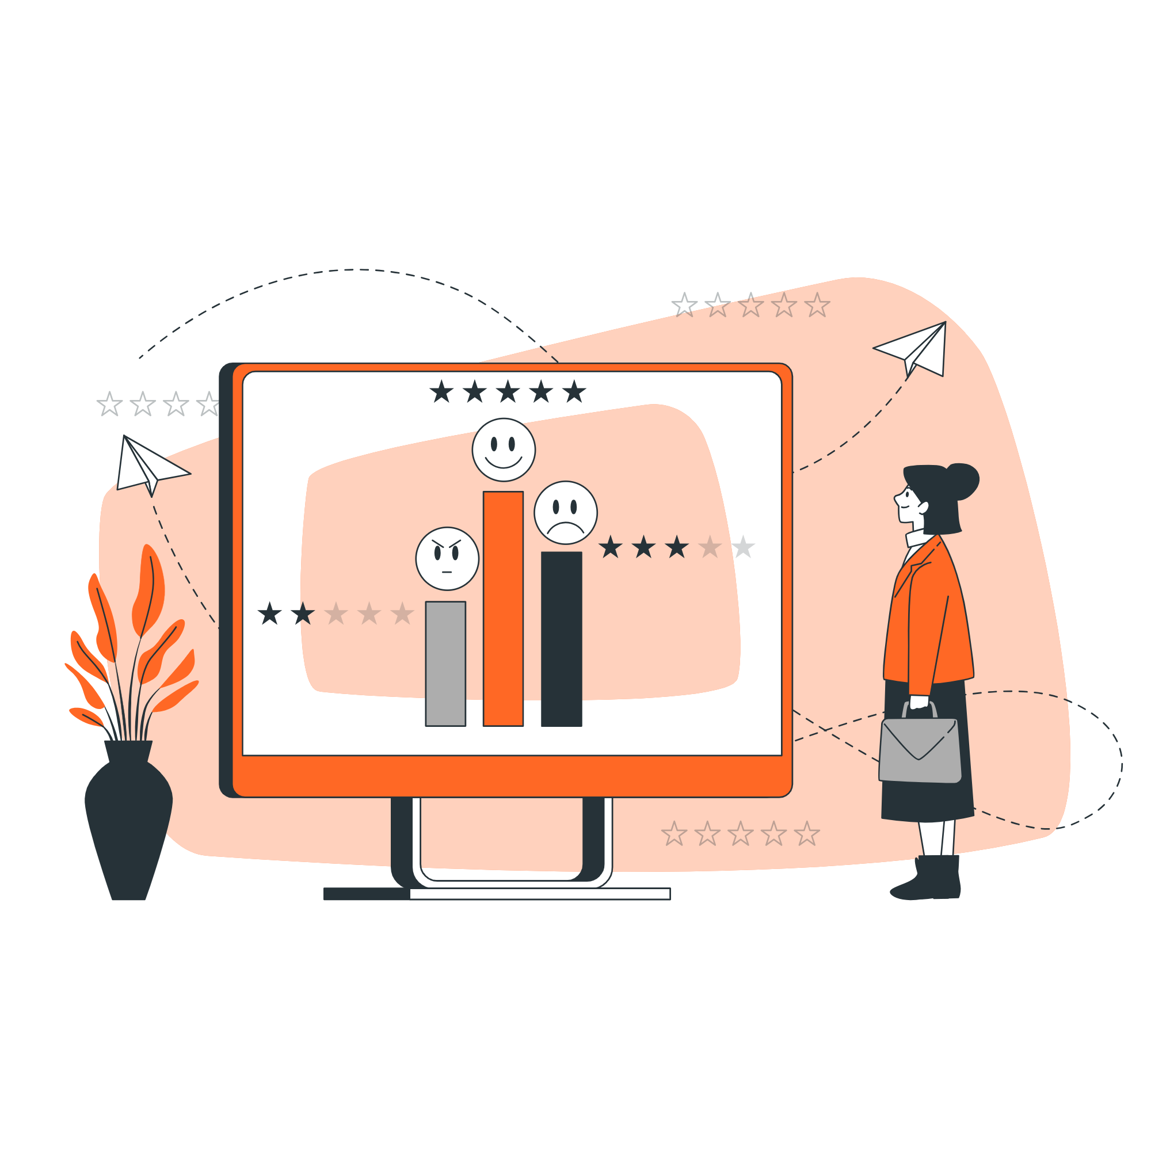
ORANGE TELECOM CHURN
Keep Customers. Grow Value.
Presented by
Ihediohamma Confidence .C.

Slide 2
Table of contents
Problem Statement
Business
Objectives
Introduction
Recommendation
01
03
05
07
02
04
06
08
Dashboard
Overview
Key
Performance
Indicators
Analysis
Insights
Conclusion

Slide 3

Introduction
Customer churn is a major challenge in the telecom industry, as losing customers directly impacts revenue and growth. With
With increasing competition and customer expectations, understanding why customers leave has become critical for business success.
This analysis focuses on identifying the key factors driving customer churn by examining customer service interactions, service plans, usage patterns, and customer tenure. The goal is to uncover
actionable insights that can help improve customer retention, enhance service quality, and support data-driven decision-making.

Slide 4
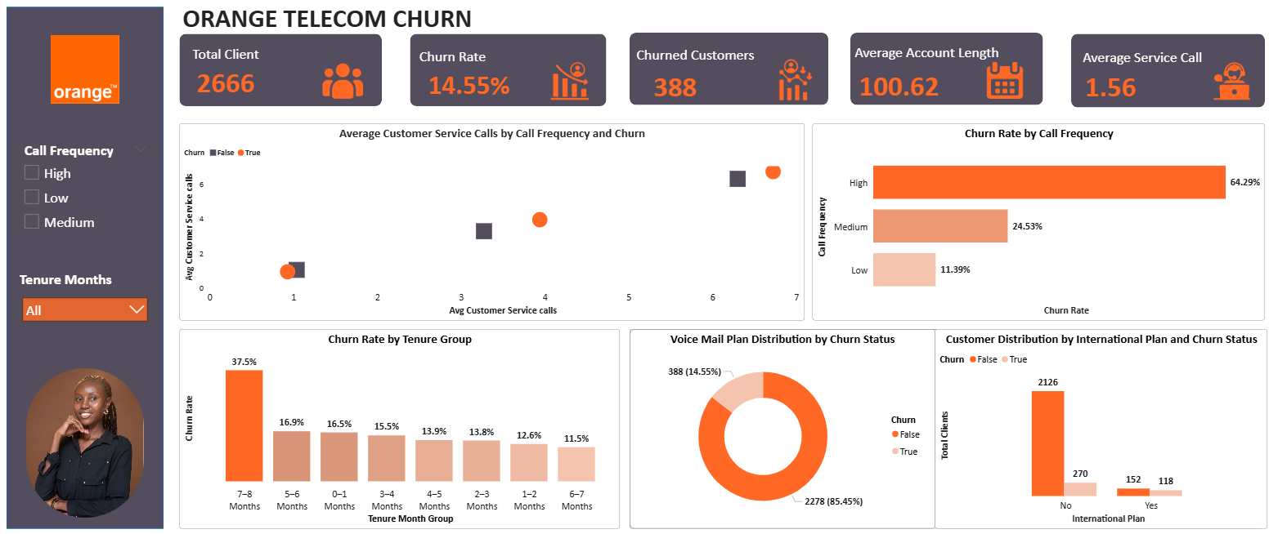

Slide 5
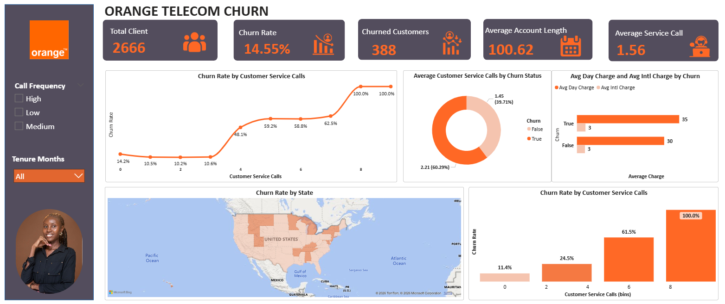

Slide 6

Problem Statement
Orange Telecom is experiencing customer churn and lacks clear insight into the key factors driving customer attrition. This analysis aims to identify the impact of customer service interactions, plan subscriptions, usage patterns, and customer tenure on churn, in order to support data-driven strategies for improving customer retention and reducing churn rates.

Slide 7






Key Performance Indicators
Total Customers: 2666
Total number of customers.
Churn Rate: 14.55%
Percentage of customers who have churned
Churned Customers: 388
Total number of customers who left
Average Account Length: 100.62 Days
Customers stay with the company for approximately 3.3 months on average.
Average Customer Service Calls: 1.56
Average number of service calls made by customers

Slide 8

Business Objectives
Analyze how customer service interactions, including call frequency, influence customer churn and satisfaction.
Identify the key drivers of churn by examining customer behavior, service usage, and tenure.
Evaluate the impact of service plans, such as International and Voice Mail, on customer retention.
Assess how usage patterns and charges relate to churn and potential price sensitivity.
Identify high-risk customer segments and explore regional variations in churn patterns

Slide 9
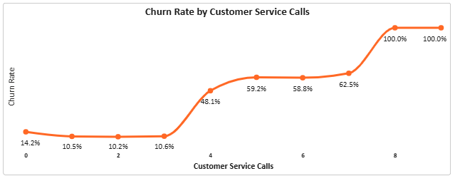
Key Insights
Churn increases significantly with the number of customer service calls, indicating a strong relationship between customer dissatisfaction and churn.
Customers with low call frequency (0–2 calls) have minimal churn (10%), while those with 6–8 calls experience extremely high churn rates (60%–100%).
A clear tipping point exists at 4+ service calls, where churn rises sharply from 10.6% to 48.1%, highlighting a critical threshold of unresolved issues.
This pattern suggests that repeated customer service interactions are a strong indicator of dissatisfaction, and customers with frequent complaints represent a high-risk segment for churn.

Slide 10
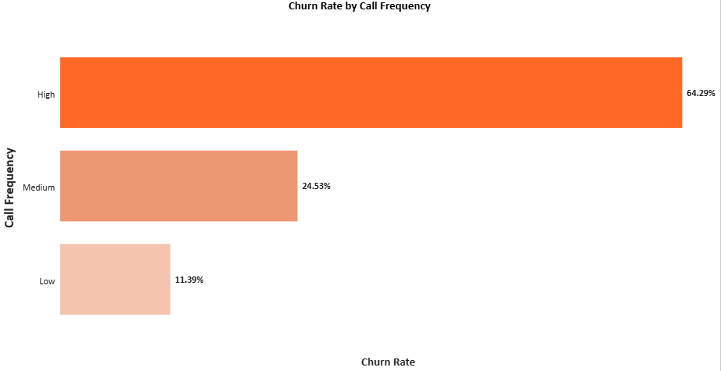
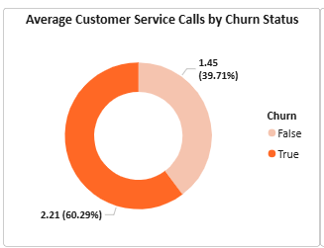
Customer Service and Churn Risk
Customers in the high call frequency segment show significantly higher churn rates:
High frequency: 64% churn
Medium frequency: 24% churn
Low frequency: 11% churn
Churned customers make more customer service calls on average compared to retained customers
Churned customers: 2.21 calls
Retained customers: 1.45 calls
Increased customer service interaction is a strong indicator of dissatisfaction, and customers with frequent complaints represent a high-risk segment for churn.

Slide 11
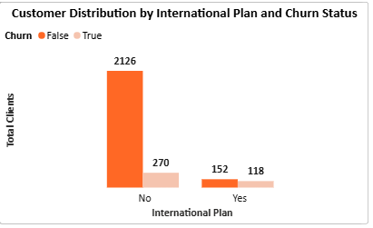
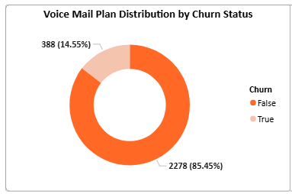
Product, Pricing and Usage Influence
The majority of customers do not subscribe to the international plan, and churn is observed across both users and non-users.
Customers with voice mail plans are more commonly retained, suggesting a positive relationship with customer loyalty.

Slide 12
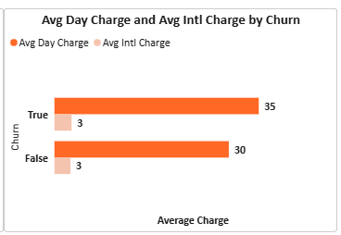
Product, Pricing and Usage Influence
Churned customers exhibit slightly higher average daily charges compared to retained customers.
While service plans and pricing factors influence churn behavior, they are not the primary drivers. However, value-added services like voice mail plans may support retention, and higher charges may contribute to churn due to perceived cost or value concerns.

Slide 13
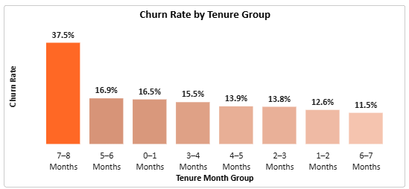
Churn Rate by Customer Tenure Group
Churn generally decreases as customer tenure increases, indicating improved retention over time. However, there is a significant spike in churn at the 7–8month tenure stage (37.5%), which is notably higher than other groups. This suggests that even longer-tenured customers are not fully retained and remain at risk of churning
The pattern indicates that churn is not only an early-stage issue but may also be driven by factors such as:
Declining perceived value over time
Pricing concerns
Accumulated unresolved service issues

Slide 14

Recommendations
Improve customer service efficiency by resolving issues within the first 2–3 interactions and reducing repeated customer complaints.
Implement an early warning system to identify customers with frequent service calls and proactively engage them with retention offers.
Provide targeted support for high-risk customers through personalized follow-ups, discounts, and service recovery strategies.
Strengthen onboarding and early customer engagement with guidance, check-ins, and incentives to reduce early-stage churn.
Optimize pricing and service offerings by reviewing plan value, promoting voice mail adoption, and addressing regional service issues

Slide 15
Conclusion
Customer churn at Orange Telecom is largely driven by poor customer service experience, especially among customers with frequent support interactions. As service calls increase, the likelihood of churn rises significantly, with a clear tipping point after multiple unresolved issues.
Newer customers are also more likely to churn, highlighting gaps in early customer experience and onboarding. While pricing and plan subscriptions have some impact, they are less significant compared to service-related factors, though value-added services like the voice mail plan support retention.
Overall, improving customer service efficiency, identifying at-risk customers early, and enhancing customer engagement are key to reducing churn and strengthening long-term customer loyalty.

Slide 16
Thank
You

